Slide 1
Obsessive Compulsive Disorder (OCD)
Dr Emily O’Leary
Clinical director

Slide 2
Overview
Welcome!
Audience goals
Question and Answer format
Question time
Refreshments

Slide 3
What is OCD?
OCD is characterized by obsessions and/or compulsions that are significantly impairing and distressing
Functional impairment for more than 1 hour per day
American Psychiatric Association. (2000).
Notes:
MOVIE
Significant genetic component
Abnormalities in circuits linking basal ganglia to cortex (March & Mulle, 1998).
Pathways often used in grooming activities (e.g., washing, picking, licking)
Neurotransmitter and neuroendocrine irregularities

Slide 4
What are the types of OCD?
Obsessions
Contamination themes
Harm to self or others
Aggressive themes
Sexual themes
Scrupulosity/religiosity
Forbidden thoughts
Symmetry urges
Need to tell, ask, confess
Compulsions
Washing or cleaning
Repeating
Checking
Touching
Counting
Ordering/arranging
Hoarding
Praying

Slide 5
When does it start?
Usual onset in late teens or early twenties, 6-15 for males and 20-29 for females
80% of adults with OCD have childhood onset (Kessler, 2005)
Two-thirds of all adults with OCD had symptoms before age 15, 80 percent of whom also had symptoms of depression.
Average total of 17 years between onset of symptoms (age 14.5) and appropriate treatment (age 31.5)

Slide 6
What is the course?
Although OCD usually develops gradually, psychosocial stressors like changes in living situations, relationship problems, or work problems can cause sudden onset.
About 70% of people experience a waxing and waning
About 5% have episodic symptoms with partial or complete remission between episodes.

Slide 7
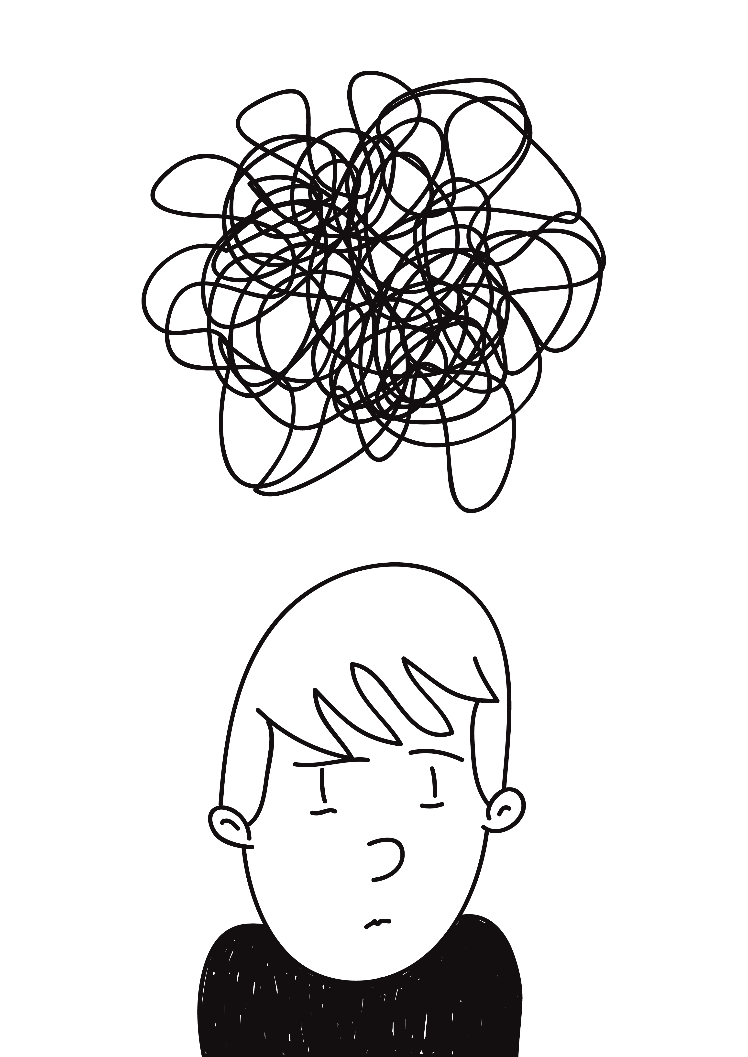
How can OCD be understood?
Unacceptable intrusions are a normal occurrence
When intrusions have occurred, the person with OCD believes that they might be responsible for harm if they don’t react to prevent it
They respond by TRYING TOO HARD (to get rid of the thought, to prevent harm, to be sure, to be clean…..and so on).
As time goes by, THE SOLUTION BECOMES THE PROBLEM.
Ref: Salkovskis

Slide 8
What causes it?

Slide 9
Why can’t they stop?
Obsessions
Anxiety
Compulsions
Avoidance
Reassurance
Short Term Relief

Slide 10
How do you treat it? = Cognitive Behavioural Therapy

Slide 11
What does CBT involve?
Basic information (“Psycho-education”; what is anxiety etc)
Making sense of what’s really going on
Deciding on goals
Changing beliefs which drive anxiety and motivate safety seeking behaviours (compulsions)
Testing it out: finding out for sure how the world really works!
Reclaiming your life

Slide 12
How psychological treatments for anxiety disorders work
People suffer from anxiety because they think situations as more dangerous than they really are.
Treatment helps the person to consider alternative, less threatening explanations of their problem
If the alternative explanation is to be helpful
It has to fit with your past experience
It has to work when you test it out
Good therapy is about two (or more) people working together to find out how the world really works
There are two experts in the room....they need to combine their expertise!
Ref: Salkovskis “Making CBT Work”
Notes:
Why should we bother with any of this theory stuff? Because knowledge is power. So now we have a idea of ocd works – what do we need to do to get rid of it? Effective psychological treatment

Slide 13
How do I get the most from treatment?
Choose the right therapist for you
Remember:
You know more about your problem than your therapist
Therapists need your help
Ask if the sessions can be audio recorded
May have to do this yourself
Good tape recorder, external microphone
Listen to the tapes and make notes!
Ask questions
Don’t shy away from trying out new ways of doing things
Be clear about your goals
Ref: Salkovskis “Making CBT Work”

Slide 14
Helpful tips in therapy?
“The journal of a 1000 miles begins with single step”...but not every journey that starts with a single step has to be 1000 miles! – Step Plans
Aim to be as consistent as possible in doing tackling your OCD, rather than doing it as a quick test that you force yourself to do
It’s not just what you do, it’s how you do it that’s important: “cheating” just delays progress - good to be anxious walking away from a compulsion
Your unlikely to get this right all the time & that’s ok – people never progress in a perfectly straight line
Setbacks are helpful provided you pick yourself up and keep going
The intention in CBT (in the first instance) isn’t to reduce anxiety or get rid of the thoughts – it’s to accept they are there but it is a “false threat”
The Golden Rule: always do the opposite of what the problem tells you to do
Ref: Salkovskis “Making CBT Work”

Slide 15
How can loved ones help?
Recognize Signals and watch for behavior changes
Remember That People Get Better at Different Rates
Avoid Day-To-Day Comparisons
Recognize “Small” Improvements
Create a Supportive Environment
Set Limits, But Be Sensitive to Mood
Keep Communication Clear and Simple
Separate Time Is Important
It Has Become All About the OCD!
Keep Your Family Routine “Normal”
Be Aware of Family Accommodation Behaviors
Consider Using a Family Contract
(From Learning to Live with OCD) By Barbara Van Noppen, PhD and Michele Pato, MD

Slide 16
Questions?

Slide 17
Contact Details
OCD Clinic
Hawthorne Medical Centre
Suite 2, 171 Riding Road
Balmoral, QLD 4171
PO Box 297
Morningside, QLD 4171
www.ocdclinicbrisbane.com.au
Ph: 07 3041 1164
Fax: 07 3399 9481
Email: admin@anxietyhouse.com.au

